Slide 1
Capstone Project The Battle of Neighborhoods
Carmen Pérez García
2019, September

Slide 2
Introduction
This report aims to analyze the city of Madrid and establish, based on different criteria, the best place to install a dental clinic.
Madrid is the capital of Spain, so it is an pretty big city and has a very abundant population, being one of the most important capitals of Europe.
It is also a city that has a great tourist attraction, so many areas of the capital are occupied by businesses dedicated to attract tourists.
In this sense, it should be noted that, when looking for a suitable location for a dental clinic, it is necessary to look for an area with a high number of fixed inhabitants, that do not vary over time and that can be established as fixed business customers, so it is necessary to avoid the most tourist areas and look for residential areas but with a high economic activity.

Slide 3
Data Analysis
The aspects to study when evaluating an adequate location for a dental clinic would be:
Number of inhabitants
Per capita income of the inhabitants
Existing businesses in the surroundings
Adequate communication with the rest of the city
Touristic attractions nearby

Slide 4
Data acquisition
To solve the problem the following data is needed:
Districts Madrid data(code, name, coordinates, area, habitants...): This information has been obtained form different websites, and has been stored as shp. and csv. files.
Map of the distribution of underground stations
Different business in the neighborhood: thanks to Foursquare API, we can obtain information about the venues in each neighborhood

Slide 5
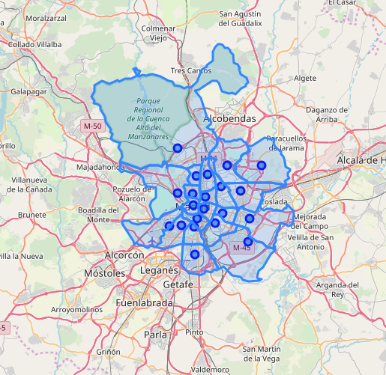
Madrid Map
This image represents the districts of the city in Madrid.
We will have to choose one of them to locate a new dental clinic.

Slide 6
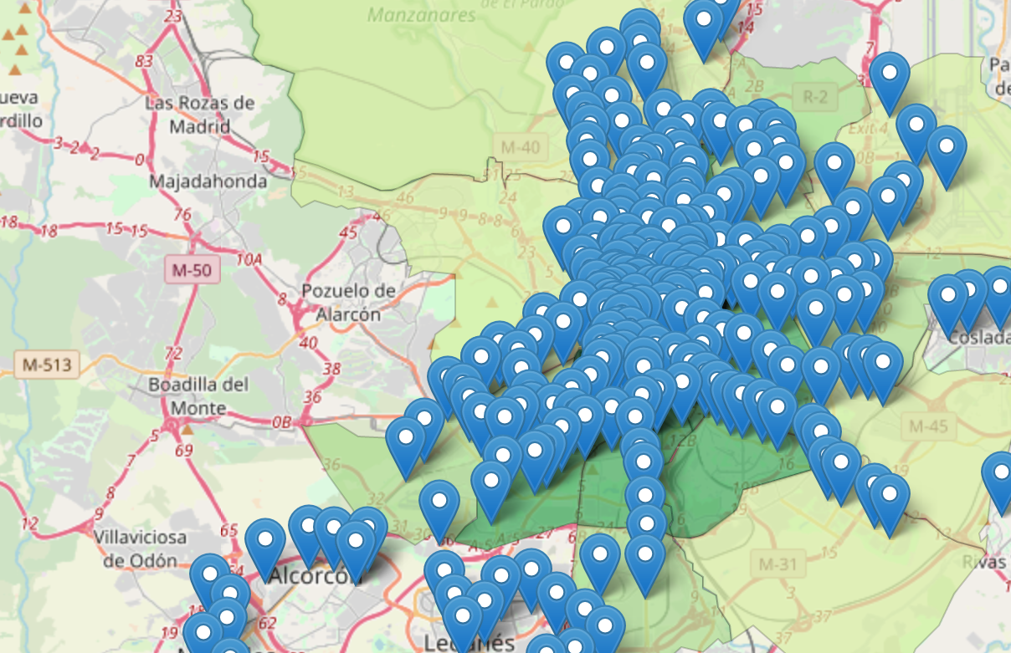
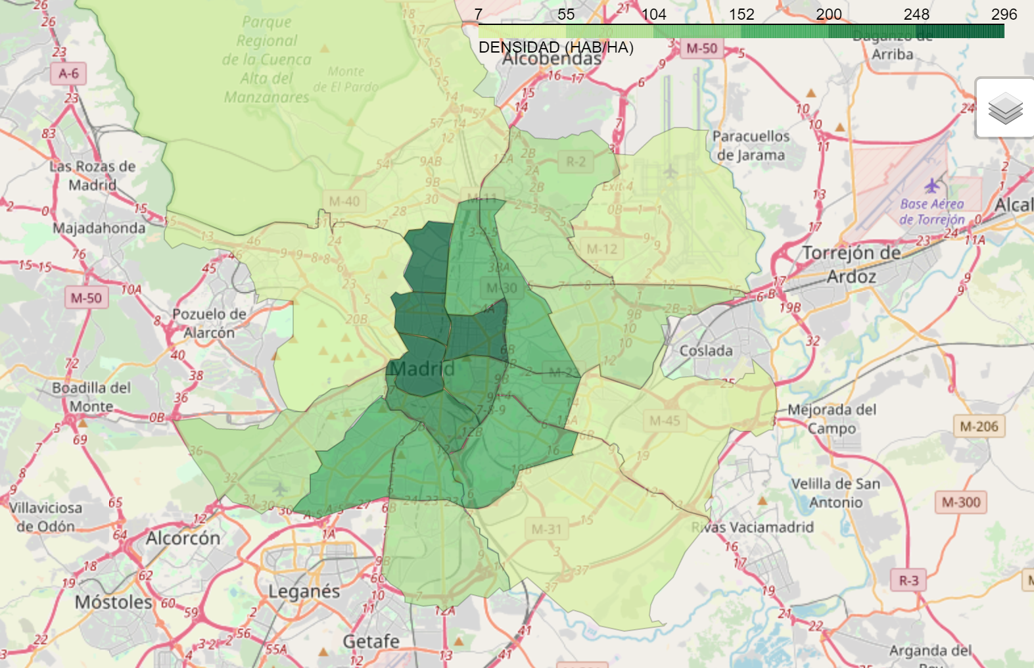
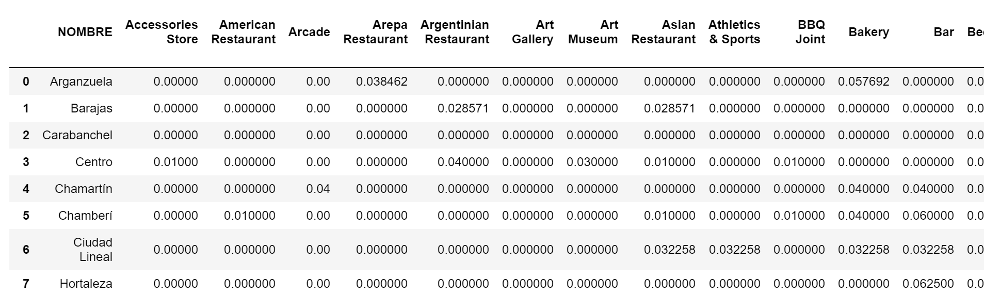
Condicionants:
As mentioned, the main conditions analyzed are:
Communications
The population density
Businesses present in the different districts.

Slide 7
Analysis (I/III)
The process to do the analysis has been as follows:
First, the map with the districts of Madrid has been downloaded in shp format .Geojson has been transformed and a map of the area has been generated with folium.
Secondly, the population, area and population density data of each district in .csv format have been obtained.
This information has been combined with the district layer and a chloropleth type map with folium has been generated.
Subway stations have been incorporated into this map, which had previously been downloaded in shp format and transformed to geojson.

Slide 8
Analysis (II/III)
Cluster 0 corresponds to the most central and tourist districts. With numerous restaurants and tourist attractions
Cluster 0 corresponds to the most central and tourist districts. With numerous restaurants and tourist attractions
Cluster 1 corresponds to peripheral districts with a high number of services
Cluster 1 corresponds to peripheral districts with a high number of services
Subsequently, with the foursquare API, the existing businesses in each area have been obtained and the 10 most common of each of them have been filtered
Finally, with sklearn, a clustering of the analyzed districts has been done, with the commented data
5 groups of districts have been obtained, within them it is worth to point out two of them:
Cluster 0 corresponds to the most central and tourist districts. With numerous restaurants and tourist attractions
Cluster 1 corresponds to peripheral districts with a high number of services

Slide 9
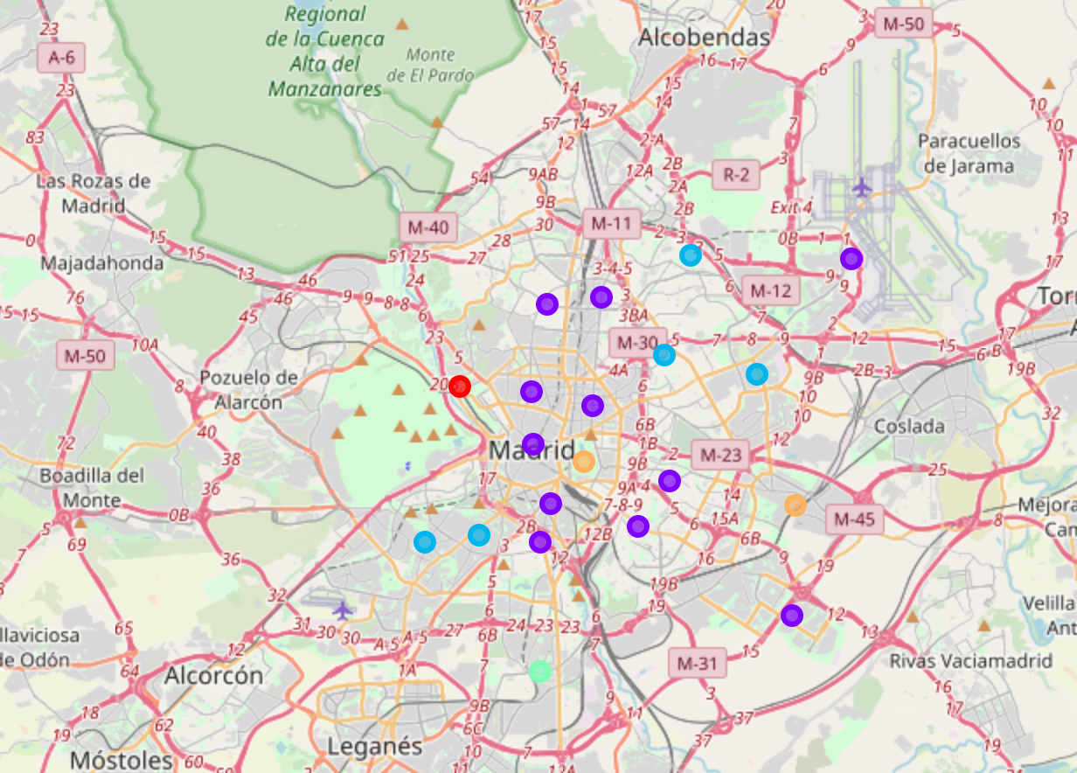
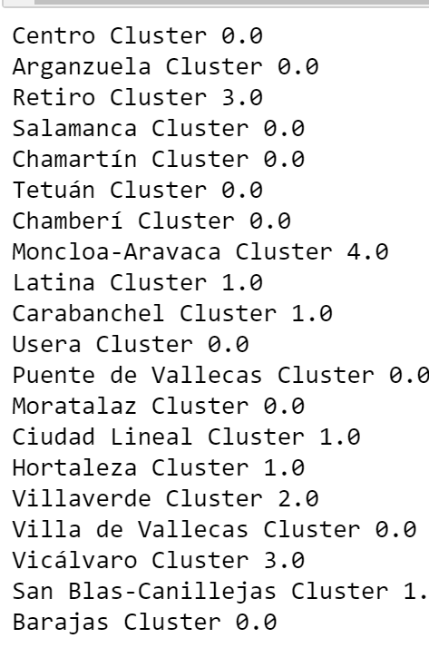
Analysis (III/III)

Slide 10
CONCLUSIONS
To choose the district in which to locate the dental clinic, we look for a residential area, with a high number of residents and with a high commercial activity. Likewise, it must be a well-connected district, for which the metro stops of the city of Madrid have been analyzed.
As indicated, the appropriate areas would be those included in cluster 3, since they are residential areas and not heavily influenced by tourism.
Within cluster 3, districts with a greater number of inhabitants, and therefore more apt to install the new business would be Carabanchel or Ciudad lineal.
Since Carabanchel is better communicated, since it has a greater number of subway stops, in addition to a commercial activity more compatible with the new business, it is considered the most appropriate district to install a new dental clinic.

Slide 11
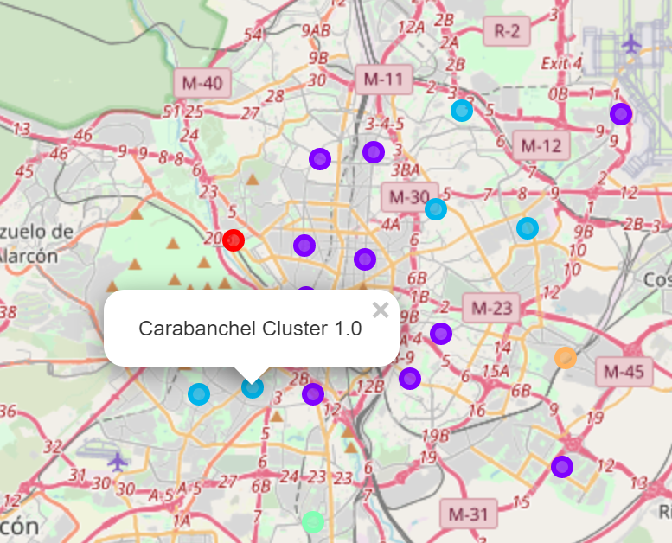
CONCLUSIONS

